Slide 1
Workshop
Experiential Knowledge
Chair: Femke Boelsma
Programme:
Nancy Lievyns (Grip): “Nothing about us without us - How to fulfill participation”
Poem by Ymke Kelders
Jacqueline Kool (DSiN): “Lived Understanding: Experiential knowledge within disability (studies) research
Poem by Ymke Kelders
Exchange of ideas

Slide 2
Nancy Lievyns
(Grip)
“Nothing about us without us - How to fulfill participation”

Slide 3
Ymke Kelders: The dance of day
As you turn the lights on in the morning
and whisper gently in my ear
While removing the blankets with a warning
I can smell you’re near
You touch my legs that spent the night in stiff position
And I feel your fingers on my knee
Every muscle changes in transition
It’s this move that sets them free
When you hold my glass and fill the dryness of my mouth
Wipe the water drops that go down my neck
You wait patiently as I swallow loud
My body doesn’t feel like such a wreck
You put me down on the toilet and give me time to pee
You wash my hands, my face, my shoulder
And gently kneel beside me
I know you are the beholder
Through you
I still belong to me

Slide 4
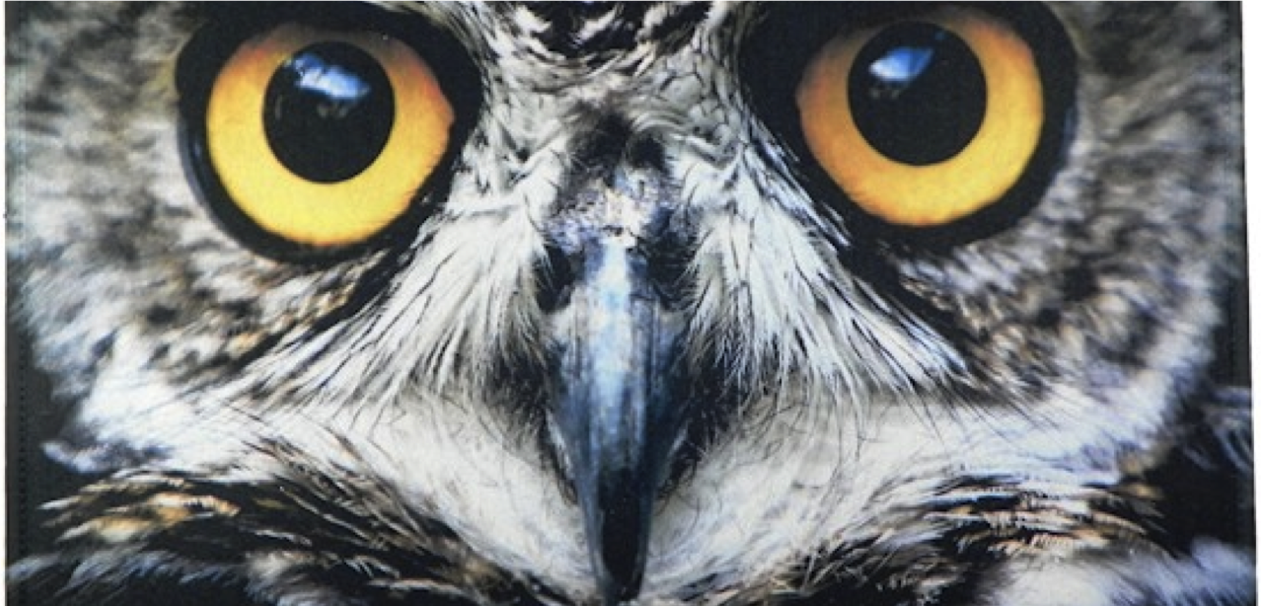
Lived understanding
Toward a conceptualization of
experiential knowledge of
persons with a disability or chronic illness
Jacqueline Kool
(Disability Studies in Nederland)

Slide 5
An explorative study on experiential knowledge from perspectives of people with a ‘double identity’
Jenny Boumans (Trimbos)
Jacqueline Kool (DSiN)
Merel Visse (VU medical center)

Slide 6
Purpose
To contribute to theoretical framework on the nature, meaning and relevance of experiential knowledge of persons with a disability

Slide 7

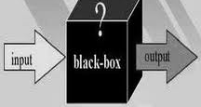
Background

Slide 8
Four main questions
What is experiential knowledge? How does it originate?
What is the role and meaning of experiential knowledge?
How can we benefit from experiential knowledge in scientific research? What are prerequisites for the use of experiential knowledge?
What is the relationship between experiential knowledge and scientific and professional knowledge?

Slide 9

Images and metaphors of experiential knowledge
a funnel

Slide 10
Method
Responsive approach
Persons with ‘double identity’
Expertmeetings
Questionnairre
Email-questionnairre
Member check, analysis and interpretation
Conceptmapping

Slide 11
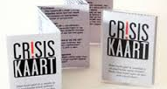
Images and metaphors

Slide 12
A map of experiential knowledge

Slide 13
What is experiential knowledge?
existential & societial
lifeworld
lived knowledge
multiple meanings
practical wisdom
performative knowledge
collection of subjective, objective and normative knowledge
identity
socially situated
embodied
process of understanding
complex, plural, holistic
disruptive

Slide 14
What is it?
‘Knowledge that has been acquired by (conscious or non-conscious) reflection on experiences that (mostly) are related to a chronic illness or disability’. (respondent questionnairre)
‘To me, experiential knowledge is a form of ‘unique wisdom’: a form of lived knowledge’ (expertmeeting)
‘You could say that experiential knowledge is something that exists ‘between’ people, instead of within people themselves’. (respondent questionnairre)

Slide 15

Images and metaphors
Being on a
Flying carpet

Slide 16
How does experiential knowledge originate?
‘Everybody has experiential knowledge and it is knowledge you gain by what you experience and knowledge you gain by thinking about what you experience.’ (expert)
‘In a way it is hidden because of certain circumstances. Experiential knowledge is made latent, people have the knowledge, but it is not addressed to it that way, that it is knowledge. (…) It concerns the activation of knowledge that is already present, and its further development (expert)
‘It originates from a feeling of alienation, how people view you, how they categorize you. (expert)

Slide 17

Images and metaphors

Slide 18
What is the content of experiential knowledge? (1)
From practical tips to wisdom
All-embracing – covers all areas of life
Four domains:
  1.Handicap/ disability; symptoms, course, barriers, coherence
  2.How to deal with handicap/disability; effects/ response person and environment
  3.Impact on QoL; barriers and facilitators (individual, societal) (NB vgl ICF)
  4.Life experiences/wisdom; non-disability related

Slide 19
What is the content of experiential knowledge? (2)
“Learning how to cope and accept, more than healthy people.” (questionnairre)
”To me, experiential knowledge entails more than just the practical issues of living with a disability. From my own viewpoint, what matters is especially the emotional/psychological development and your position within society.” (expert)
“Knowing that life is not always fun. But despite that: create meaning. That is a part of experiential knowledge that provides self-confidence.” (expert)
“Layered: you go into depth, more and more existential”; “Experiential knowledge is being aware of the vulnerability of existence and knowing that life continues.” (questionnairre)

Slide 20
Putting things into perspective & humor
“We may question whether wisdom increases.”

Slide 21
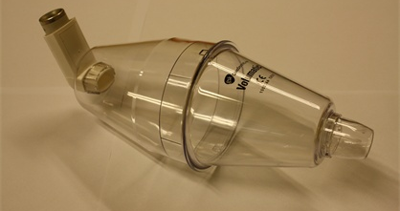
Images and metaphors
inhalor

Slide 22
What is the role (and value) of experiential knowledge?
  Personal meanings
    Praktical & existential
    Capacity to…
    Sensemaking & coping with setbacks
    Part of identity and lifestory
    ‘Experiential knowledge is not a goal, but a means to live your life within physical boundaries, to your own choice’ (questionnairre)

Slide 23
What is the role (and value) of experiential knowledge?
  Value of experiential knowledge in our society:
    Change of perspectives / alternative logic
    Impetus for societial change
    Imaging of normal and different
    Sensitive for ‘stories behind stories’
    Dialogue < > Tensions
‘My own experiential knowledge (and education, experiential knowledge is not positioned in a vacuum) makes that I might better understand that normal is just an agreement/convention.’ (questionnairre)

Slide 24
What is the role (and value) of experiential knowledge?
    Normative role
  Beyond alienation
  Understanding and support of the collective
  Drive: contributing to change!
  ‘Experiential knowledge is knowledge that emerges from perceiving and acting from the features of my own body and brain. And from a certain moment I notice that this is not the average knowledge. (…) Knowledge by which I notice I deviate from the norm’ (emailquestions)

Slide 25

Images and metaphors
A ducktape mug

Slide 26
Reflection
Complex
Layered
Sometimes a confusion of tongues:
three positions of the object of experiential knowledge

Slide 27
A. The object is the disease or disability

Slide 28
B. The object is biographical individuality

Slide 29
C. Het object is the relationship between individuality, disease and society

Slide 30
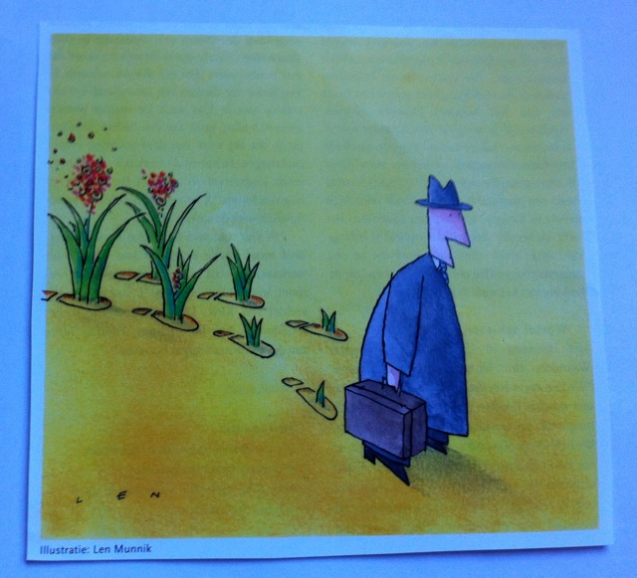
Conclusion: Seeding document…

Slide 31
Ymke Kelders: Uncontrollable movements
As I lie awake in bed
I open and I close my eyes
Press my leg to the mattress and as it rise
I get up and feel my head
Through the hallway there I move
Controlling every step, hoping you won’t be there
Wishing that without informing you went everywhere
It’s that image I want to prove
But when I come closer I already hear
Your stuffy breath and silent bones
Prostheses that are attached as clones
I hope these uncontrollable movements will never disappear
As I walk back my whole body feels heavy and strong
I know that you long, for that feeling of total control
Once again I wish I was wrong

Slide 32
Discussion
&
Exchange of Ideas

